Slide 1

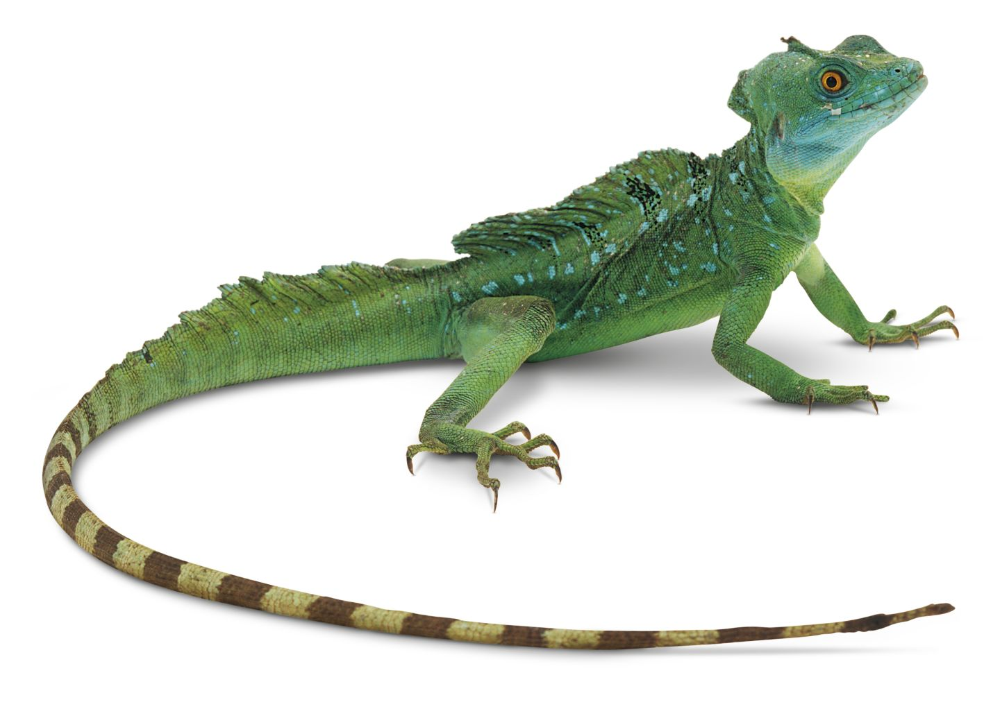
LIZARD – A Lightweight Stream Cipher for Power-constrained Devices
Matthias Hamann¹ Matthias Krause¹ Willi Meier²
¹ University of Mannheim, Germany ² FH Nordwestschweiz, Switzerland

Slide 2
Overview
Lightweight Cryptography
Traditional Stream Cipher Design
Towards Stream Ciphers with Smaller States
Sprout-like Approaches
Lizard
  Basic Properties and Difference to Grain v1
  Components (FSRs and Output Function)
  State Initialization Algorithm
  Hardware
Conclusion

Slide 3

“Lightweight!” – Well, opinions differ…

Slide 4
Ultra-constrained RFID Hardware
Targeted Platform:
Passively powered, low-cost RFID tags in the range of $0.05 to $0.10 like Electronic Product Codes (EPCs).
Technology:
Application-specific Integrated Circuits (ASICs)
  Integrated circuit customized for a particular use, rather than intended for general-purpose use.
  Typical component in the low-cost RFID context, e.g., due to low per-unit costs (for large batches).
Implementation:
Hardware Description Languages like Verilog.

Slide 5
Hardware Constraints
Resource / Property | Limit | Sources (i. a.)
Area (Security Budged) | ~ 2,000 GE | [4], [12], [13], [8], [5], [9], [2], [1]
Non-volatile Memory | ~ 2,048 bit | [1], [6], [4]
Power | ~ 10 µW | [10], [4], [12], [11]
Clock Speed | ~ 100 kHz | [3], [7], [14], [15]
  More details: Lightweight Authentication Protocols on Ultra-Constrained RFIDs - Myths and Facts; Armknecht, Hamann, Mikhalev; RFIDSec 2014.
  List of practical limits on ultra-constrained low-cost RFID tags.
  Sources: Literature, discussions with experts from industry and academia.

Slide 6
  Traditional Stream Cipher Design
Rule: State at least twice the key size (or security parameter).
Reason: Time-Memory-Data tradeoff (TMD TO) attacks based on birthday paradox.
Applies mainly if state update function is key independent.
eSTREAM finalist stream ciphers obey this rule and have key-independent update functions.
Birthday-based distinguishers on keystream?
Can work even for key-dependent update:
A Note on Distinguishing Attacks; Englund, Hell, Johansson; IEEE Information Theory for Wireless Networks, 2007.

Slide 7
  Towards Stream Ciphers with Small State
Argue: Allow distinguisher of keystream to some extent. (Block ciphers, e.g., in CTR or OFB, have birthday distinguishers as well.)
Goals:
  Lower area and power consumption than for existing designs.
  Understanding security achievable by stream ciphers with small state.
  Identify additional aspects in which existing stream ciphers may have been overdesigned for many practical applications (e.g., keystream lengths) in the past and which may allow for smaller states.

Slide 8
  Starting Point: Grain v1
Member of final eSTREAM hardware portfolio.
State size 160 bit, key size 80 bit, IV size 64 bit.

Slide 9
  Stream Ciphers with Small State
For 80 bit security, can we go lower than 160 bit state size?
One idea: Make state update key-dependent.
Cannot prevent distinguishers of keystream, but possibly key recovery. (However, no corresponding proofs against TMD TO, yet.)
Sprout: State size only 80 bit. Modelled on stream cipher Grain v1. But has been broken by several methods.
Fruit (on ePrint): A tweak of Sprout, which needs to access several non-sequential bits of the secret key per clock cycle (speed & power impact!).
Plantlet: See FSE 2017 talk by Vasily Mikhalev.

Slide 10
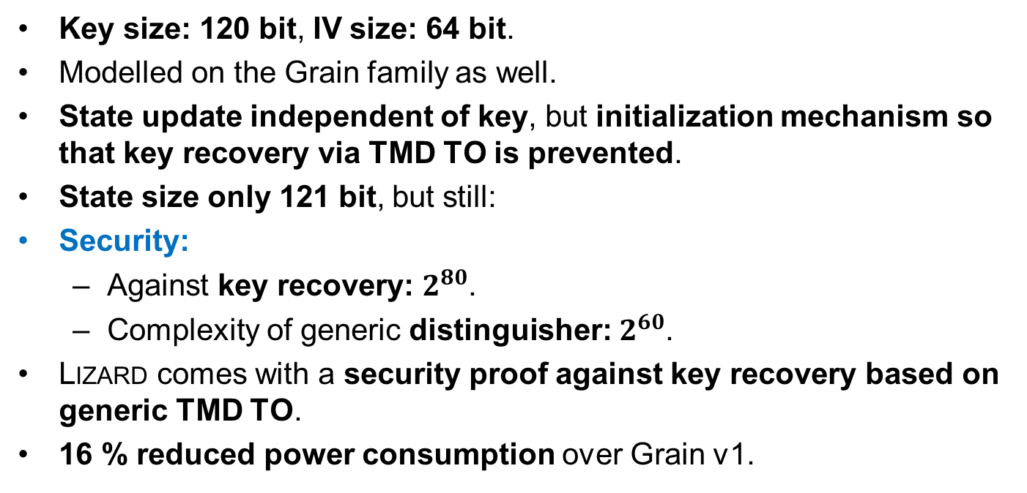
  Our Approach: Lizard
Key size: 120 bit, IV size: 64 bit.
Modelled on the Grain family as well.
State update independent of key, but initialization mechanism so that key recovery via TMD TO is prevented.
State size only 121 bit, but still:
Security:
  Against key recovery: $2^{80}$.
  Complexity of generic distinguisher: $2^{60}$.
Lizard comes with a security proof against key recovery based on generic TMD TO.
16 % reduced power consumption over Grain v1.

Slide 11
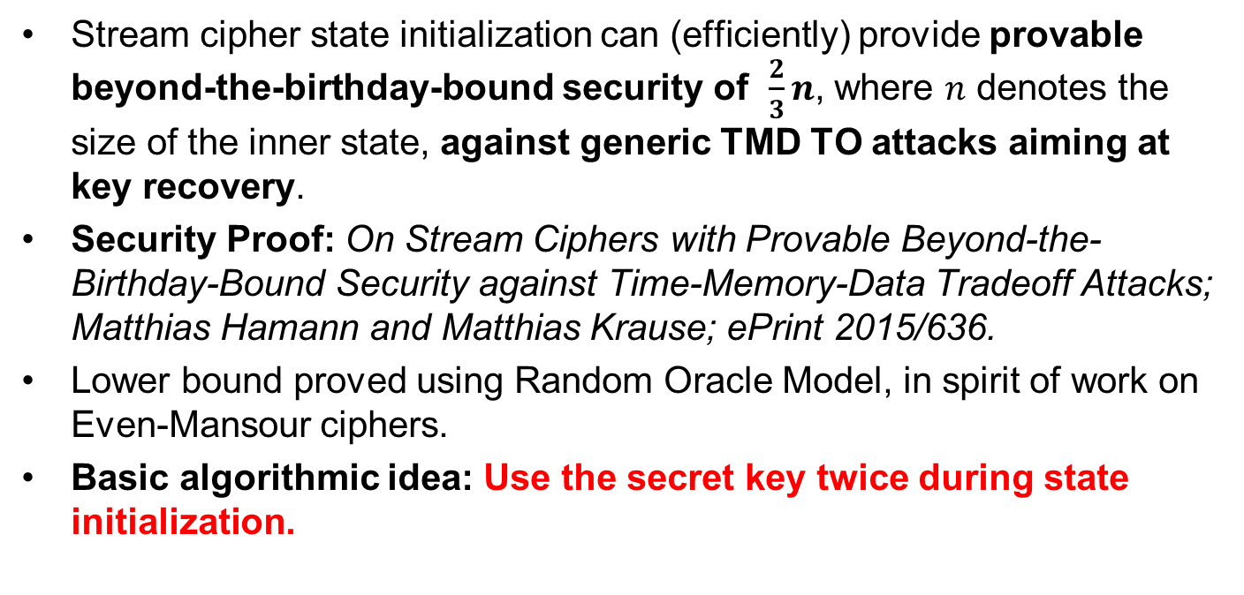
  Security of Lizard against TMD TO
Stream cipher state initialization can (efficiently) provide provable beyond-the-birthday-bound security of $\frac{2}{3}n$, where $n$ denotes the size of the inner state, against generic TMD TO attacks aiming at key recovery.
Security Proof: On Stream Ciphers with Provable Beyond-the-Birthday-Bound Security against Time-Memory-Data Tradeoff Attacks; Matthias Hamann and Matthias Krause; ePrint 2015/636.
Lower bound proved using Random Oracle Model, in spirit of work on Even-Mansour ciphers.
Basic algorithmic idea: Use the secret key twice during state initialization.

Slide 12
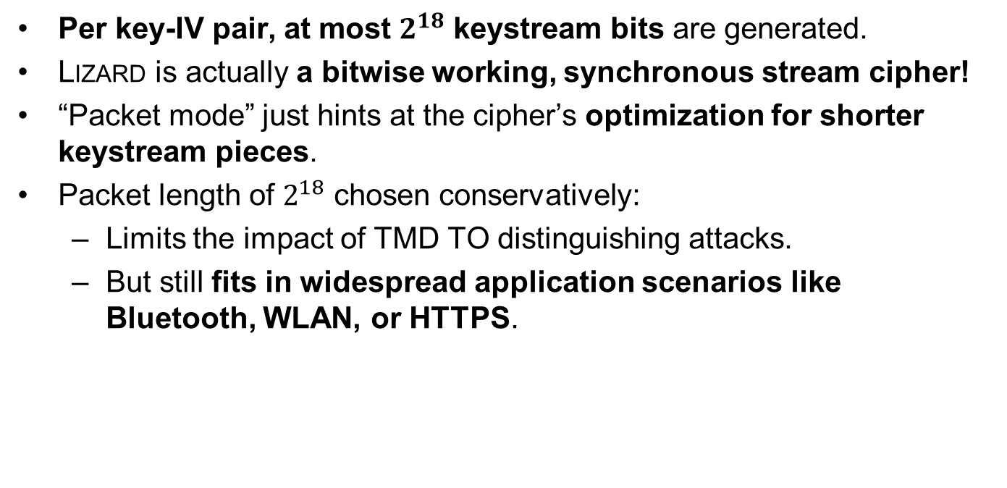
  Packet Mode
Per key-IV pair, at most $2^{18}$ keystream bits are generated.
Lizard is actually a bitwise working, synchronous stream cipher!
“Packet mode” just hints at the cipher’s optimization for shorter keystream pieces.
Packet length of $2^{18}$ chosen conservatively:
  Limits the impact of TMD TO distinguishing attacks.
  But still fits in widespread application scenarios like Bluetooth, WLAN, or HTTPS.

Slide 13
  Difference to Grain v1
Smaller state size: 121 bit (compared to 160 bit).
Larger key size: 120 bit (rather than 80 bit), necessary assumption for security proof.
Key is introduced not only once, but twice in initialization.
Quite different output function: Inspired by FLIP stream cipher, uses many (53) inputs.
Both register feedbacks now nonlinear.
Efficiently parallelizable up to a factor of 6 (compared to 16).

Slide 14
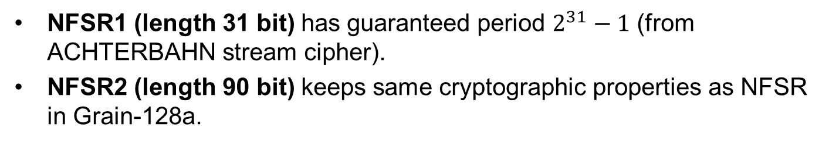
  Lizard in keystream generation mode
NFSR1 (length 31 bit) has guaranteed period $2^{31}−1$ (from ACHTERBAHN stream cipher).
NFSR2 (length 90 bit) keeps same cryptographic properties as NFSR in Grain-128a.

Slide 15
  Lizard’s output function $a$
Depends on 53 inputs, shared carefully between NFSR1 and NFSR2.
If NFSR1 (the smaller FSR) assumed to be known, the remaining output function satisfies cryptographic properties well.
In particular, remaining function still nonlinear.
In contrast to Grain v1, where the output function becomes linear in NFSR state bits if LFSR state assumed to be known.
As in FLIP, output function is a sum of linear, quadratic and triangular functions.
Fulfills the known design criteria for output function of a stream cipher.
Tap selection based on concept of full positive difference sets.

Slide 16
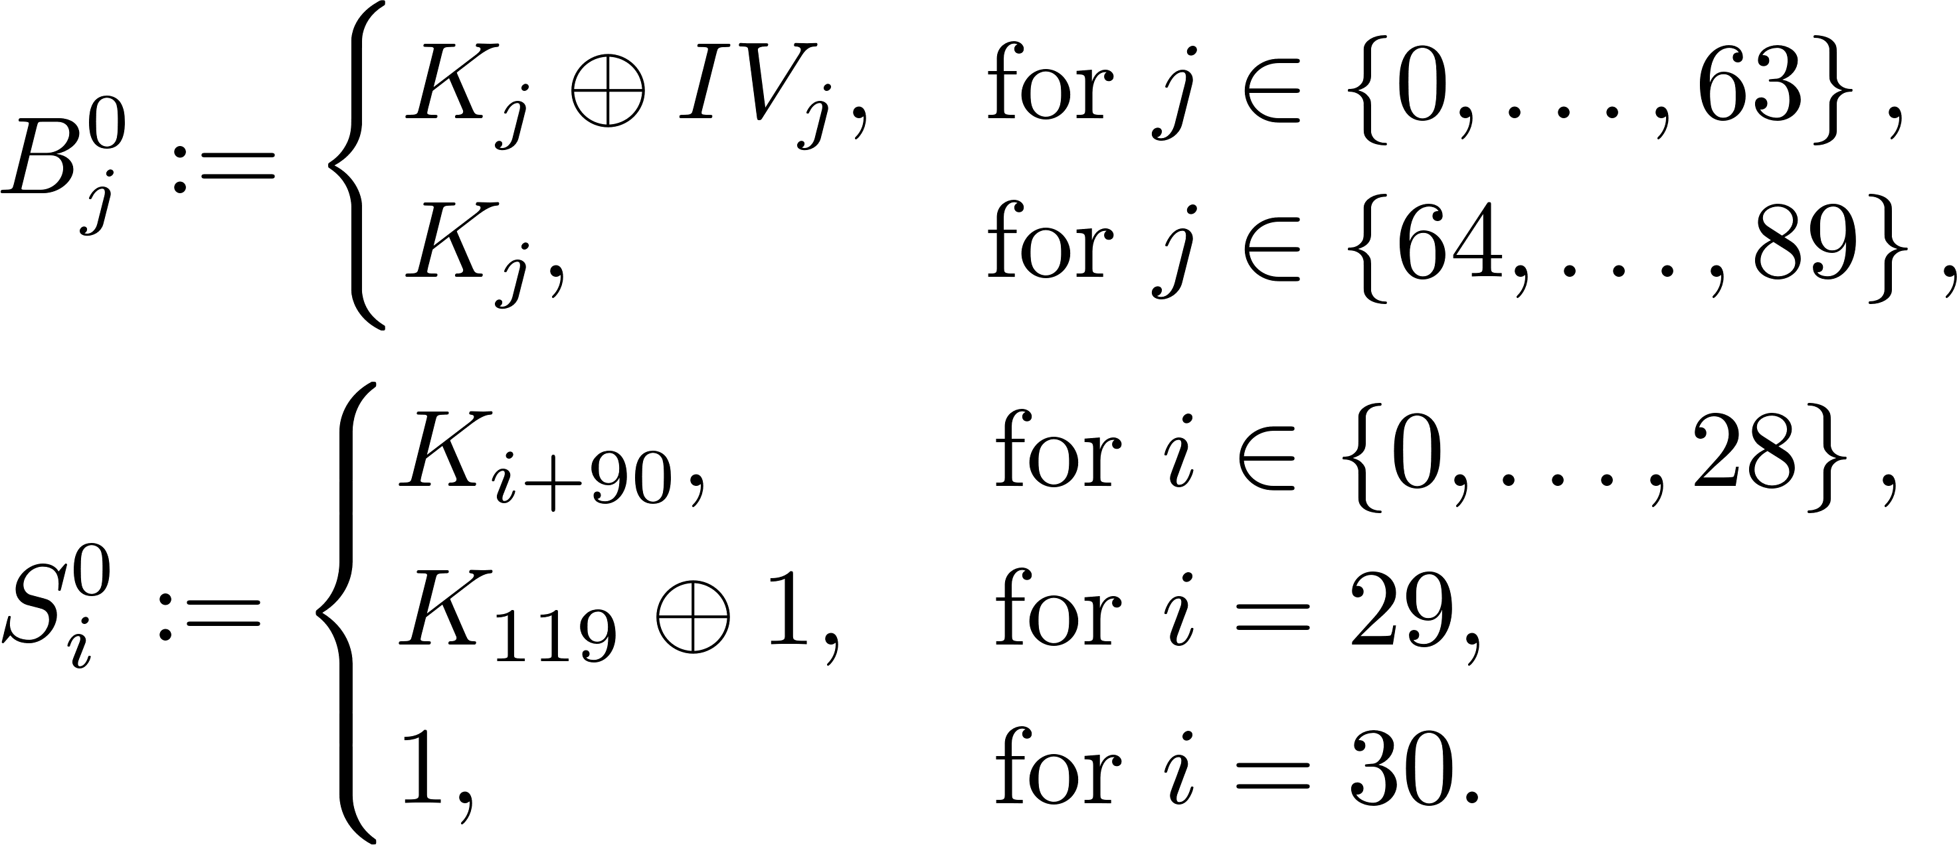

  Lizard’s State Initialization
Adapts FP(1)-mode (Hamann and Krause; ePrint Report 2015/636) as follows:
  Phase 1: Key ($K_{0}⋯K_{119}$) and IV (${IV}_{0}⋯{IV}_{63}$) loading

Slide 17
  Lizard’s State Initialization
  Phase 2: Grain-like mixing (128 clock cycles)

Slide 18
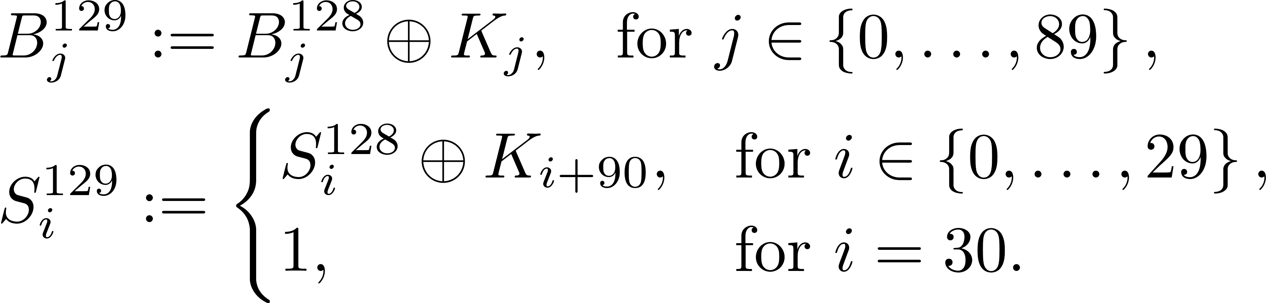
  Lizard’s State Initialization
  Phase 3: Second key addition (same key as in Phase 1)
  Phase 4: Final diffusion (128 clock cycles, no output produced)

Slide 19
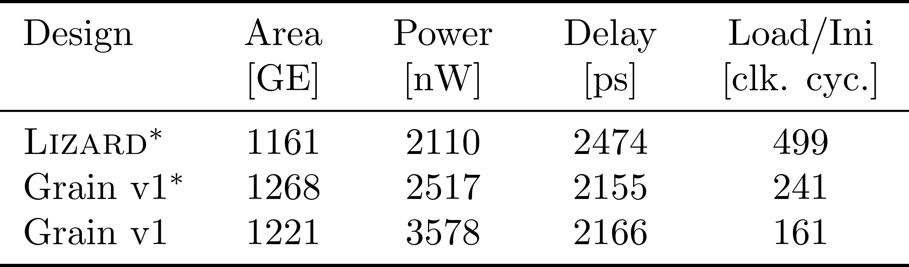
Hardware Results
Clock speed of 100 kHz.
* indicates serialized key/IV loading.
Load/Ini: Number of clock cycles needed to perform the state initialization.
After state initialization, all designs produce one keystream bit per clock cycle (i.e., 100 kbit/s).

Slide 20
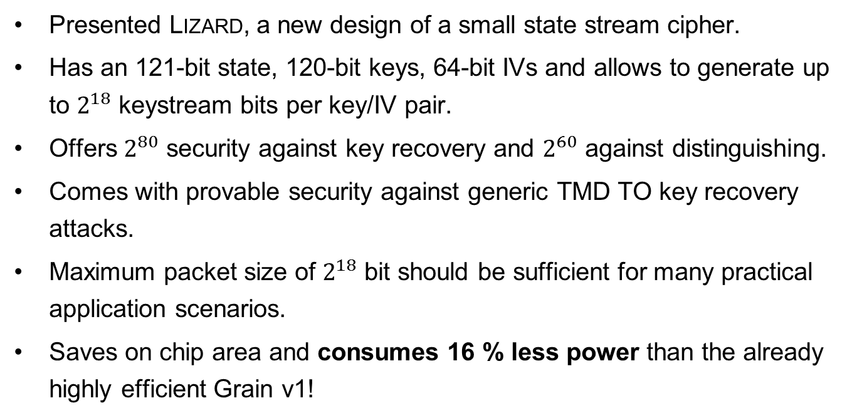
Conclusion
Presented Lizard, a new design of a small state stream cipher.
Has an 121-bit state, 120-bit keys, 64-bit IVs and allows to generate up to $2^{18}$ keystream bits per key/IV pair.
Offers $2^{80}$ security against key recovery and $2^{60}$ against distinguishing.
Comes with provable security against generic TMD TO key recovery attacks.
Maximum packet size of $2^{18}$ bit should be sufficient for many practical application scenarios.
Saves on chip area and consumes 16 % less power than the already highly efficient Grain v1!

Slide 21
References w.r.t. Hardware Constraints (1)
P. H. Cole and D. C. Ranasinghe: Networked RFID Systems and Lightweight Cryptography: Raising Barriers to Product Counterfeiting, 2008.
M. Feldhofer, J. Wolkerstorfer, and V. Rijmen.: AES implementation on a grain of sand, 2005.
M. Feldhofer, S. Dominikus, and J. Wolkerstorfer: Strong authentication for RFID systems using the AES algorithm, 2004.
A. Juels and S. A. Weis: Authenticating pervasive devices with human protocols, 2005.
J. Melià-Seguí, J. Garcia-Alfaro, and J. Herrera-Joancomartí: J3Gen: A PRNG for low-cost passive RFID, 2013.
A. Nuykin, A. Kravtsov, S. Timoshin, and I. Zubov: A low cost EEPROM design for passive RFID tags, 2012.
P. Peris-Lopez, J. C. Hernandez-Castro, J. M. Estevez-Tapiador, and A. Ribagorda: LAMED - a PRNG for EPC Class-1 Generation-2 RFID specification, 2009.
A. Poschmann, A. Moradi, K. Khoo, C. Lim, H. Wang, and S. Ling : Side-channel resistant crypto for less than 2,300 GE, 2011.
D. C. Ranasinghe, D. W. Engels, and P. H. Cole : Low-cost RFID systems: Confronting security and privacy, 2005.

Slide 22
References w.r.t. Hardware Constraints (2)
C. A. Repec: Regulatory status for using RFID in the EPC Gen 2 band (860 to 960 MHz) of the UHF spectrum, 2013.
C. Rolfes, A. Poschmann, G. Leander, and C. Paar: Ultralightweight implementations for smart devices - security for 1000 gate equivalents, 2008.
M.-J. O. Saarinen and D. W. Engels: A do-it-all-cipher for RFID: Design requirements (extended abstract), 2012.
W. Wu and L. Zhang: LBlock: A lightweight block cipher, 2011.
M. Feldhofer: Comparison of Low-Power Implementations of Trivium and Grain, 2007.
T. Good and M. Benaissa: Hardware performance of eStream phase-III stream cipher candidates, 2008.

Slide 23

Thank you for your attention!

Slide 24
Appendix: Hardware Constraints (1)
Area:
  Measured in Gate Equivalents (GE): 1 GE = area of a two-input NAND gate.
  Common implementation tradeoff: Area vs. speed (serial/round-based/parallel).
  Limit: ~ 2,000 GE (security budget).
  (AES ~ 3,400 GE, SKINNY-64-128 ~ 1,696 GE, Grain v1 ~ 1250 GE.)
Non-volatile Memory (NVM):
  Volatile memory limits included in area constraints (e.g., for flip-flops).
  Prevalent technology: EEPROMs (costly in terms of speed and power).
  Alternatives w.r.t. key storage: Masks, fuses.
  Limit: ~ 2,048 bit.

Slide 25
Appendix: Hardware Constraints (2)
Power:
  (Low-cost / Ultra-constrained) Tags are passively powered.
  Limiting factors: Transmission power of RFID readers (e.g., due to legal regulations), temperature issues in medicine (Δ < 1 °C), …
  Numbers strongly depend on the technology library.
  Limit: ~ 10 µW.
Clock Speed:
  Limited esp. by power constraints.
  Important w.r.t. transmission (encryption/decryption) times.
  Limit: ~ 100 KHz.

